Slide 1
Benchmarking Lightweight CNN for Real-Time Classification of Bangladeshi Mango Varieties on Edge Devices
Undergraduate Thesis Defense
Computer Science and Engineering Jahangirnagar University

Slide 2


Presentation Outline
Part I: Foundation
Part II: Implementation
•
Introduction & Background
•
Proposed Framework & Dataset
•
Problem Statement
•
Benchmarking CNN Architectures
•
Research Objectives
•
AmmChini AI App Deployment
•
Literature Review Summary
•
Conclusion & Future Work

Slide 3

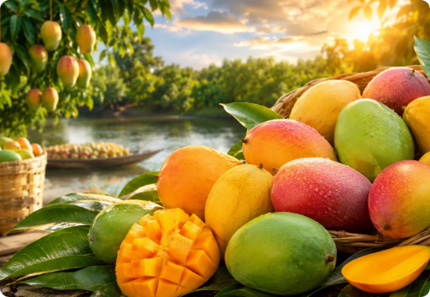
Introduction
•
Mango is an economically significant horticultural crop in Bangladesh.
•
Accurate identification is essential for pricing, quality control, and export chains.
•
Current identification methods rely strictly on manual visual inspection.
•
Manual sorting is labor-intensive, subjective, and highly inconsistent.
•
Strong need for automated, objective classification systems in rural orchards.

Slide 4






Background & Motivation
High Similarity
Deep Learning
Field Deployment
Indigenous varieties like Langra and Kanchon Langra exhibit extremely subtle morphological differences.
CNNs can automatically learn discriminative visual features, vastly outperforming manual human extraction.
Real-world agriculture requires portable, reliable systems accessible to farmers directly in the orchard.

Slide 5
Problem Statement
Heavy Computational Demands: State-of-the-art CNNs (ResNet, DenseNet) require powerful GPUs, rendering them unsuitable for low-end mobile edge devices.
Cloud Dependency: Transmitting images to servers causes latency and entirely fails in rural areas lacking stable internet infrastructure.
Fine-Grained Classification: Existing models often struggle with the subtle inter-class similarities unique to Bangladeshi mangoes.
Deployment Gap: A distinct lack of end-to-end frameworks that balance predictive performance with realistic mobile efficiency.

Slide 6
Research Objectives
Benchmark Architectures: Evaluate 5 lightweight CNNs on the Mangifera2012 dataset for performance and efficiency.
Architecture-Specific Preprocessing: Implement robust, model-specific training pipelines for fair comparative evaluation.
Optimize for Edge: Convert the best-performing model to TensorFlow Lite using Float16 post-training quantization.
Mobile Deployment: Develop "AmmChini AI", a Flutter app for fully offline, real-time prediction.

Slide 7


Literature Review Summary
Current Trends
Identified Research Gap
Most studies prioritize accuracy using computationally expensive models (e.g., ResNet50, YOLOv4).
Limited benchmarking of lightweight models strictly for resource-constrained mobile deployment.
Datasets primarily feature international commercial cultivars (Kent, Alphonso) rather than indigenous ones.
Lack of complete end-to-end Edge AI implementations capable of functioning without internet connectivity.

Slide 8
Proposed Framework
2. Benchmarking
4. Deployment
Training and evaluating 5 lightweight CNNs via Transfer Learning.
Integration into the AmmChini AI Flutter app for offline inference.
1. Preparation
3. Optimization
Dataset organization, resizing, and architecture-specific preprocessing.
TensorFlow Lite Float16 quantization for the optimal edge model.

Slide 9
Dataset Description
Mangifera2012 Dataset: 2,012 High-Resolution RGB Images
Variety | Image Count | Variety | Image Count
Amrapali | 252 | Kanchon Langra | 210
Bari-4 | 235 | Katimon | 163
Bari-7 | 176 | Langra | 202
Fazlee | 156 | Mollika | 221
Harivanga | 202 | Nilambori | 195

Slide 10






Preprocessing & Augmentation
Image Resizing
Dynamic Preprocessing
Online Augmentation
Images standardized to 224x224 pixels to balance computational efficiency and fine-grained feature preservation.
Architecture-specific normalization applied dynamically to match ImageNet pre-training distributions.
Random rotation, shift, shear, zoom, and flip applied dynamically during training to enhance generalization.

Slide 11
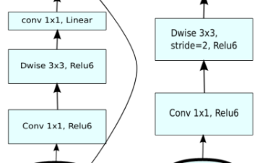
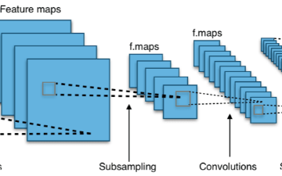

Benchmarked CNN Architectures
MobileNetV2 & V3-Small: Inverted residuals, depthwise separable convolution, Squeeze-and-Excitation.
EfficientNetV2B0 & DenseNet121: Compound scaling, fused MBConv blocks, and dense feature reuse.
NASNetMobile: Automatically discovered optimal cell structures using Neural Architecture Search.

Slide 12
Experimental Setup
Transfer Learning: All models initialized with ImageNet pre-trained weights to leverage generic visual features.
Frozen Backbone: Base feature extractors were frozen during initial training to prevent immediate overfitting.
Custom Classification Head: The exact same custom head was appended to all models to ensure fair comparison:
○
Global Average Pooling Layer
○
Dropout Layer (0.30 Rate)
○
Dense Layer (128 neurons, ReLU Activation)
○
Softmax Output Layer (10 classes)

Slide 13
Performance Comparison
CNN Model | Accuracy (%) | Weighted F1 (%) | Size (MB) | Latency (ms)
EfficientNetV2B0 | 92.00 | 91.98 | 24.6 | 57
MobileNetV3-Small | 91.25 | 91.22 | 7.2 | 31
DenseNet121 | 90.25 | 90.21 | 33.1 | 71
MobileNetV2 | 89.75 | 89.71 | 9.8 | 43
NASNetMobile | 88.50 | 88.42 | 20.5 | 49
* MobileNetV3-Small selected for optimal Edge AI deployment balance.

Slide 14
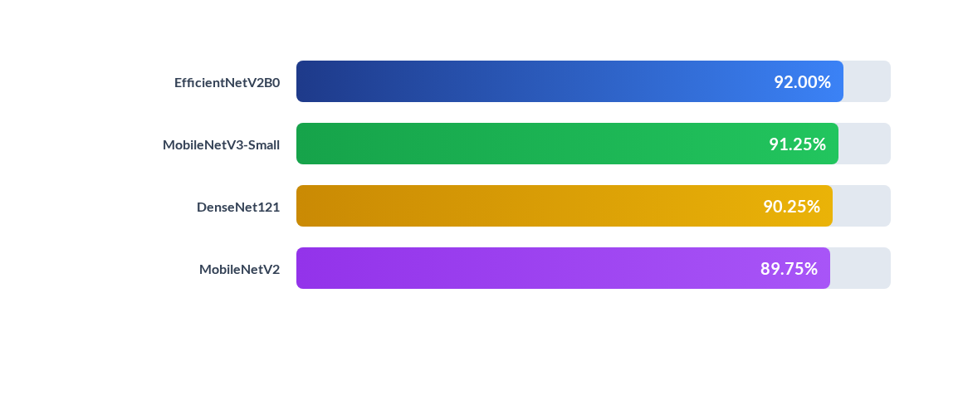
Evaluating Model Efficiency
MobileNetV3-Small achieves near-parity in accuracy while remaining a fraction of the physical size, demonstrating extreme parameter efficiency.

Slide 15
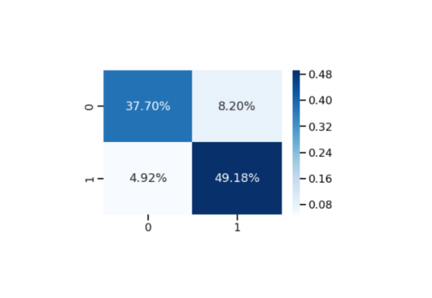
Confusion Matrix Analysis
•
Perfect Classification: Fazlee, Katimon, and Mollika achieved 100% recognition without error.
•
High Accuracy: Amrapali and Langra demonstrated excellent separability.
•
Significant Improvement: MobileNetV3-Small resolved much of the Bari-4 vs. Kanchon Langra confusion seen in baseline models.
•
Persisting Challenge: Nilambori remained difficult, often confused with Bari-7 and Bari-4 due to near-identical green peel textures.

Slide 16
Why MobileNetV3-Small?
The Optimal Edge Choice
While EfficientNet achieved slightly higher accuracy, it was too heavy for low-end smartphones. MobileNetV3-Small was chosen because it provides:
31ms
•
Storage: Only 7.2 MB model size.
•
Speed: Real-time execution without delays.
Inference Latency
•
Accuracy: 91.25% robust precision and recall.
•
Architecture: Hard-Swish and Squeeze-and-Excitation mechanisms ideal for fine-grained Edge AI.

Slide 17
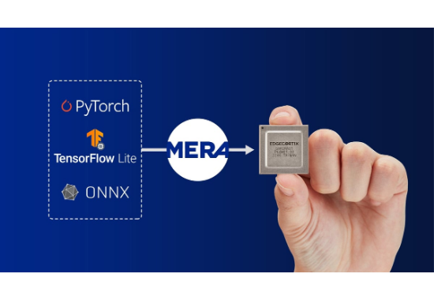
TensorFlow Lite Quantization
Float16 Post-Training Quantization
To enable highly efficient smartphone execution, the selected model was converted to TFLite format.
•
Reduces model weights from 32-bit floats to 16-bit floats.
•
Drastically shrinks storage footprint on the device.
•
Maintains identical classification performance.
•
Lowers CPU memory consumption during active inference.

Slide 18
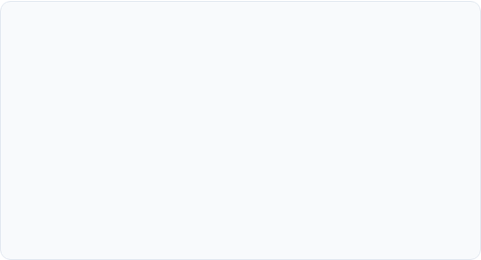
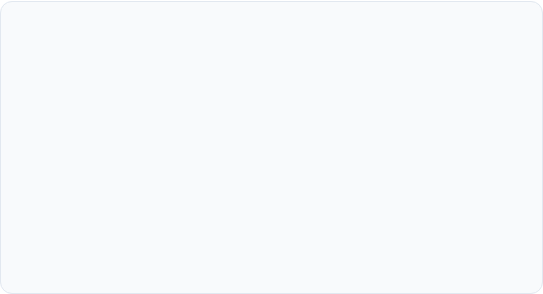
AmmChini AI App Architecture
Flutter Frontend
TFLite Backend
Cross-platform UI handling the camera interface and gallery image selection.
Local execution of the MobileNetV3 interpreter directly on the device CPU.
Responsive design tailored for rural users to view predictions clearly and easily.
Zero reliance on external APIs or servers, ensuring complete offline capability.

Slide 19

Live Prediction Workflow
4. Prediction
2. Preprocessing
Image is resized to 224x224 and converted into a Float32 byte stream.
Highest probability class is returned.
1. Acquisition
3. Inference
User captures or selects a mango image via the app.
TFLite model runs forward propagation locally to output probabilities.

Slide 20






Advantages of Edge AI
Offline Operation
Low Latency
Privacy & Cost
Works seamlessly in rural orchards lacking reliable internet or cellular infrastructure.
Sub-second, real-time inference without frustrating network communication delays.
Images never leave the device, ensuring privacy and eliminating recurring cloud API costs.

Slide 21
Conclusion
This research successfully bridged the gap between academic computer vision and practical agriculture. By benchmarking and optimizing MobileNetV3-Small, we delivered AmmChini AI: a highly accurate, fully offline Edge AI solution for classifying indigenous Bangladeshi mango varieties.

Slide 22
Future Work
Dataset Expansion: Collect more images across varying geographical regions, lighting, and maturity stages.
Object Detection: Transition from single-image classification to bounding-box detection for batch sorting.
Disease Diagnosis: Integrate multi-task learning to detect plant diseases alongside variety classification.
Explainable AI (XAI): Implement techniques like Grad-CAM to show farmers exactly which features influenced the AI's decision.

Slide 23
Questions & Answers
Thank you for your attention and time.
Thesis Defense Presentation Computer Science and Engineering Jahangirnagar University

Slide 24






Image Sources
https://biftuflwhccyadwcnfsc.supabase.co/storage/v1/object/public/news-images/news/2xz9fmtgaoq-1781341244151.webp
Source: www.eureflect.com
https://user-images.githubusercontent.com/26739999/142563365-7a9ea577-8f79-4c21-a750-ebcaad9bcc2f.png
Source: mmpretrain.readthedocs.io
https://www.kamwithk.com/_next/image?url=https%3A%2F%2Fcdn.hashnode.com%2Fres%2Fhashnode%2Fimage%2Fupload%2Fv1581407554752%2FyRvKaUe8a.png&w=3840&q=75
Source: www.kamwithk.com
https://img.freepik.com/premium-photo/futuristic-brain-with-circuit-lines-digital-glow-symbolizing-artificial-intelligence-technology_323960-5258.jpg
Source: www.magnific.com
https://miro.medium.com/v2/resize:fit:1400/1*ZEf7GRjQPwzW6KtleTvnaA.png
Source: medium.com
https://22042014.fs1.hubspotusercontent-na1.net/hub/22042014/hubfs/Hero-Images/Connecting-Edge-AI-Software-Blog-Image.jpg?width=1200&length=1200&name=Connecting-Edge-AI-Software-Blog-Image.jpg
Source: www.edgecortix.com

